Slide 1
AI Observability Workshop
Safia Gourani
Principal Solutions Engineer
Build your own LLM
Chris André
Senior Solutions Engineer

Slide 2
Agenda
How did we get here?
➔ Explaining how LLMs came to be and the various concepts associated to it.
Presentation of the demo application
➔ Explaining how LLMs came to be and the various concepts associated to it.
How do we instrument the demo application?
Introduction to OpenLLMetry and how it works
AI Obs with Dynatrace
What can you do with Dynatrace with regards to AI Observability?

Slide 3
Before we start

Slide 4
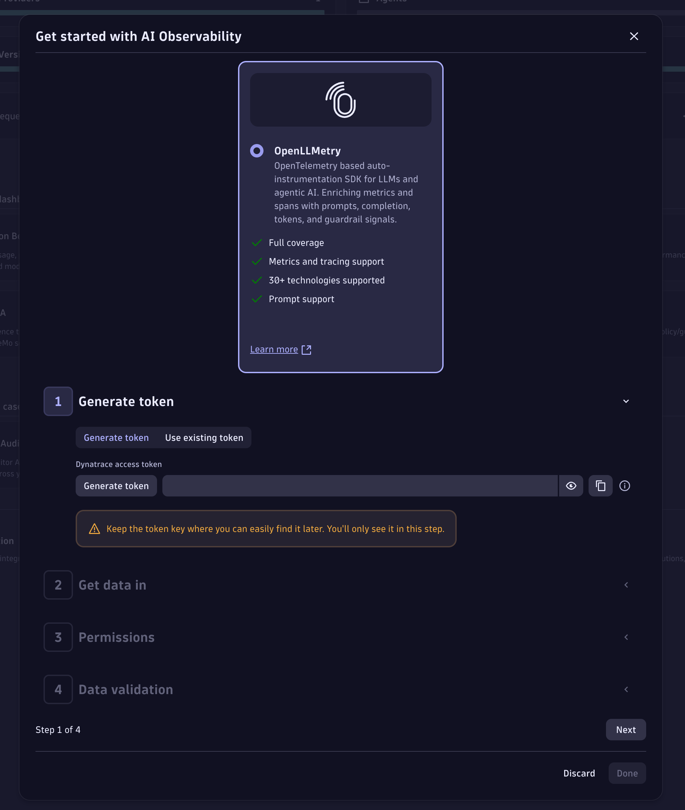
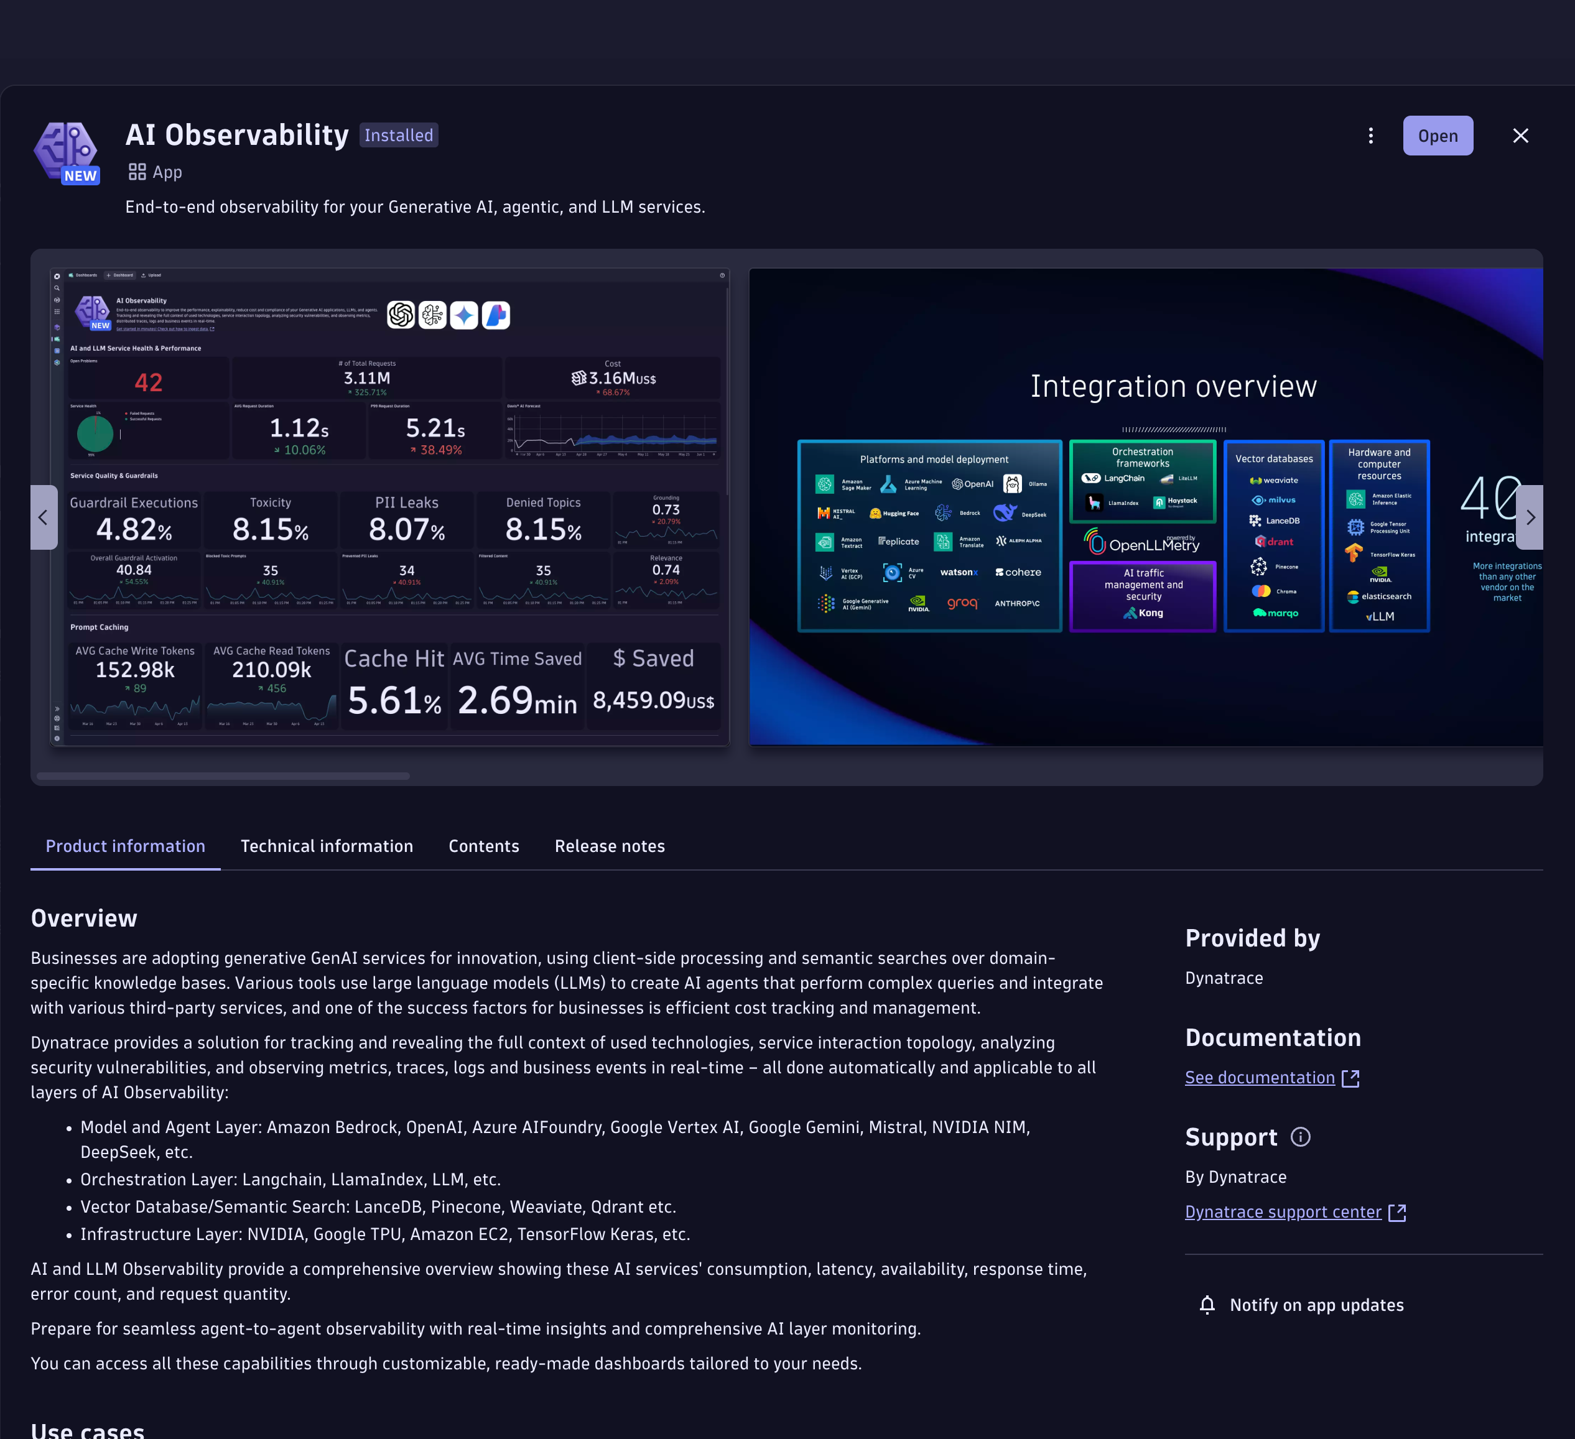
Before we start
Slide Tips
Instructions are not visible during Show Mode
To Insert Image:
Drag the image from your source folder onto the slide or click the placeholder to select a photo
To reposition your photo, click “Picture Format” and then “Crop”
Note:
You can move the mockup where you want in the slide, but take care to select both the mockup background and the image placeholder
Go to the Dynatrace HUB and search for “AI Observability”.
Install the App and open it.
On the top right, click on + Connection
Click on generate Token.
Copy the generated token to the clipboard
Follow the wizard (optional)
We are now ready to use it in the next step.

Slide 5
Before we start
This is the repository we will be using:
https://github.com/dynatrace-wwse/enablement-gen-ai-llm-observability
Codespaces configuration
Branch
select the main branch
Machine sizing
As a machine type select 4-core
Secrets (enter your credentials within the following variables)
DT_ENVIRONMENT: URL of your Dynatrace tenant
DT_LLM_TOKEN: Token that was created in the previous step

Slide 6
How did we get here?
A quick review of various LLM concepts

Slide 7
Slide Tips
Instructions are not visible during Show Mode
To Insert Image:
Drag the image from your source folder onto the slide or click the placeholder to select a photo
To reposition your photo, click “Picture Format” and then “Crop”
Note:
You can move the mockup where you want in the slide, but take care to select both the mockup background and the image placeholder

Slide 8
Neural Networks

Slide 9
Base image Source: Wikipedia - By Karin Langner-Bahmann, upload von Martin Bahmann - Own work, CC BY-SA 3.0, https://commons.wikimedia.org/w/index.php?curid=3020045

Slide 13
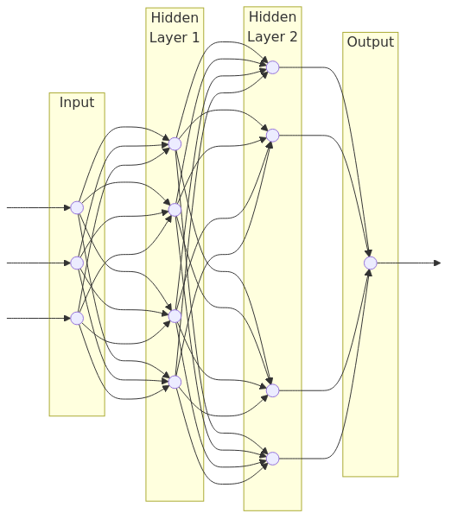

Slide 14
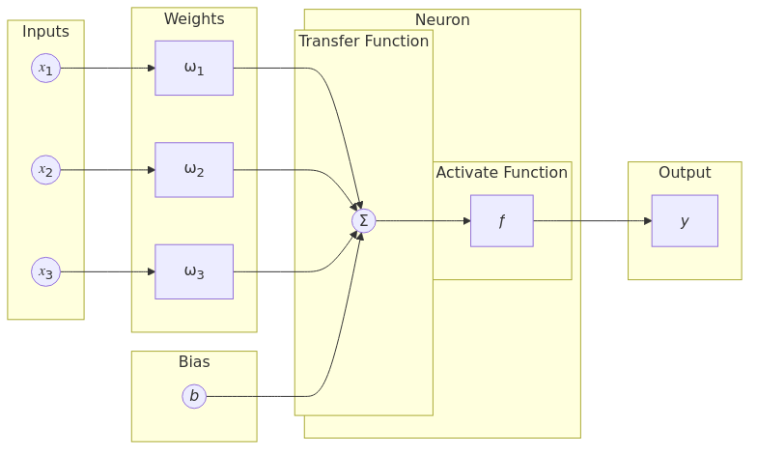

Slide 15
Applying Neural Networks to text

Slide 16
Applying Neural Networks to text
The problem with neural networks is they require numeric values as inputs.
How do we apply these to text?

Slide 17
Applying Neural Networks to text
Many ways to do this…
First idea: we could encode one letter as a number (using ASCII, Unicode or other)
Problems:
Sequences can become extremely long
Large documents can be hundreds of characters long.
Long sequences increase memory usage, complexity and compute time.
Patterns are harder to learn
Models need to aggregate letters to syllables which then need to be aggregated to words before we finally form meanings from them.

Slide 18
Applying Neural Networks to text
Second idea: we encode whole words by creating an index as we meet the words.
"I love my cat" could be encoded as:
"I" -> 1, ”<space>" -> 2, "love" -> 3, "my" -> 4, "cat" -> 5
So this becomes 1, 2, 3, 2, 4, 2, 5.
Based on this, “My cat loves me” would be…
I | <space> | love | my | cat
1 | 2 | 3 | 4 | 5
I | <space> | love | my | cat | loves | me
1 | 2 | 3 | 4 | 5 | 6 | 7
4, 2, 5, 2, 6, 2, 7 (best case scenario)
Indeed, “loves” doesn’t exist in the index (even if “love” does) and neither does “me”.
The problem is that we need to know and index ALL possible words which is highly impractical.

Slide 19
Applying Neural Networks to text
Finally, we split words into “tokens”.
Indeed, in many languages, words are created from other words/roots hinting at the underlying meaning of the word.
For example:
- “loves” in my previous example (“My cat loves me”) is composed of a verbal root (“love”) and a conjugation.
“television” is made from Greek roots: “tele” (remote, far…) and “vision” (to see)
Associated together, this could mean “<something that allows to> see <something> remote”
This allows us to better handle unknown words and neologisms.

Slide 20

Transformers

Slide 21
Transformers
Now that we transformed our text in tokens, the next step is to generate text. To do that, we use a special kind of algorithm called a "transformer".
Basically, a transformer looks back at the n last tokens in the conversation (called a "context window") and figures out what the next token statistically should be.

Slide 22
Transformers
This is why you very often need a prompt (explicit or implicit) that the model will base itself upon to generate its reply.
This is also the reason why LLM answers look so convincing, even when they are dead wrong ("hallucinations"): they are often statistically the most accurate!
Finally, transformers often use an element of randomness called “temperature” to allow answers to change from one call to the next.

Slide 23
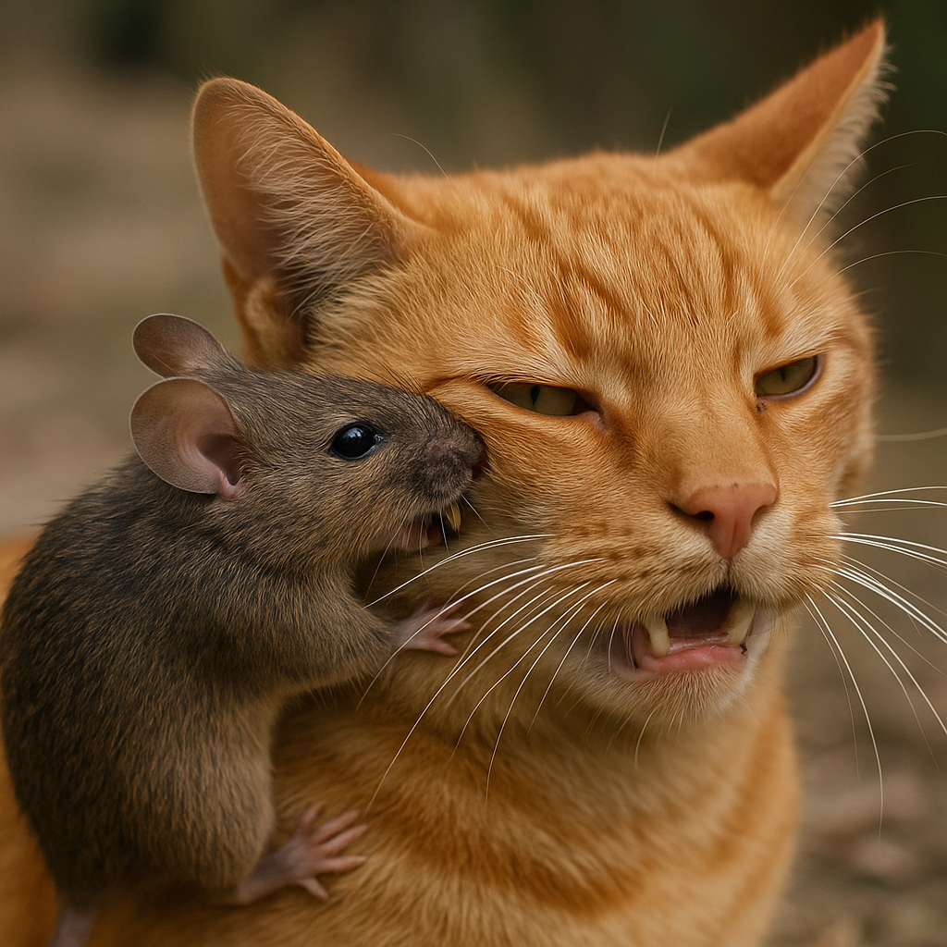
Transformers
Slide Tips
Instructions are not visible during Show Mode
To Insert Image:
Drag the image from your source folder onto the slide or click the placeholder to select a photo
To reposition your photo, click “Picture Format” and then “Crop”
Note:
You can move the mockup where you want in the slide, but take care to select both the mockup background and the image placeholder
It is also important to note that the order of the words matters and the transformer algorithm accounts for it.
"The cat bites the mouse" has a VERY different meaning from "The mouse bites the cat"...

Slide 24
Teaching a model

Slide 25
First, embeddings!

Slide 26
First, embeddings!
An embedding is, in a nutshell, a vector of values between 0 and 1 that describes a text.
For example, let's we use a simple vector with 2 values to describe:
If something is a concept or something concrete (0 is that it is usually a complete concept, 1 if it is most definitively concrete)
If it is related to animals or not (1 if it most definitively is an animal)

Slide 27
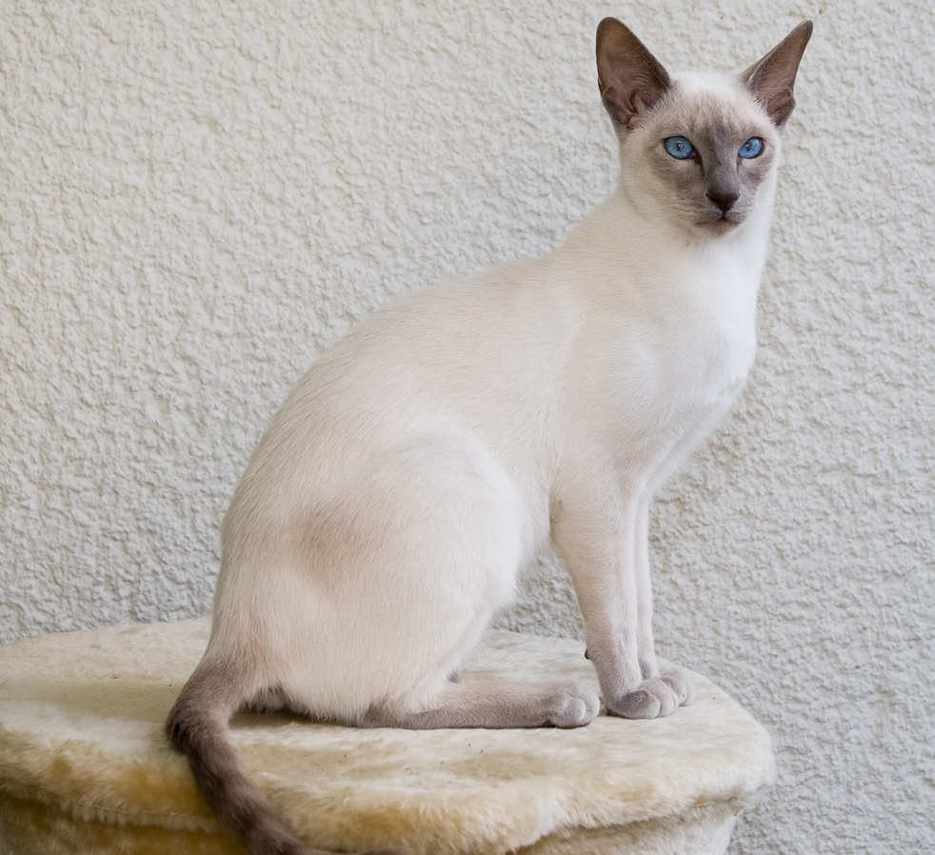
First, embeddings!
Our cat from earlier is very likely to be concrete and is definitively an animal.
Its associated embeddings would look something like [0.85, 0.8]
Source: Wikipedia - By Karin Langner-Bahmann, upload von Martin Bahmann - Own work, CC BY-SA 3.0, https://commons.wikimedia.org/w/index.php?curid=3020045

Slide 28
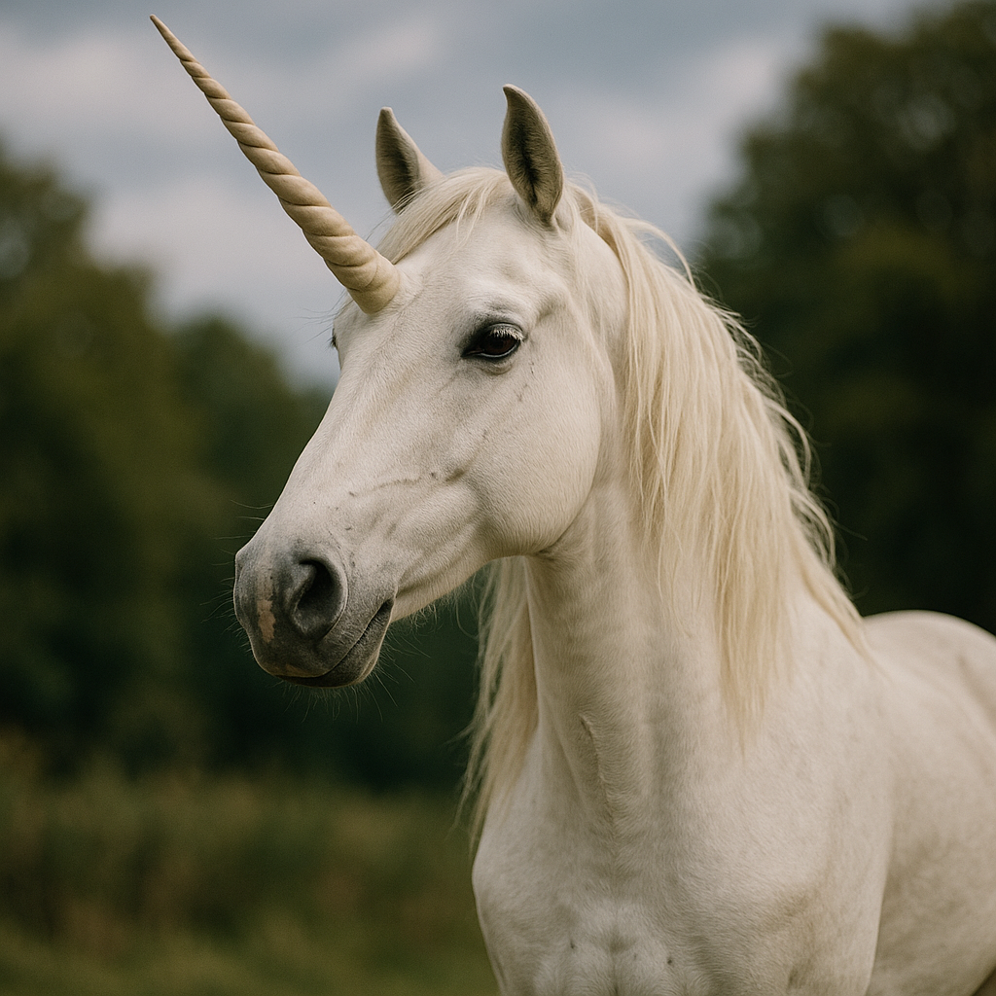
First, embeddings!
Slide Tips
Instructions are not visible during Show Mode
To Insert Image:
Drag the image from your source folder onto the slide or click the placeholder to select a photo
To reposition your photo, click “Picture Format” and then “Crop”
Note:
You can move the mockup where you want in the slide, but take care to select both the mockup background and the image placeholder
This unicorn is indeed an animal but it's more of an idea than something concrete
Its associated embeddings is therefore something like [0.23, 0.66]

Slide 29
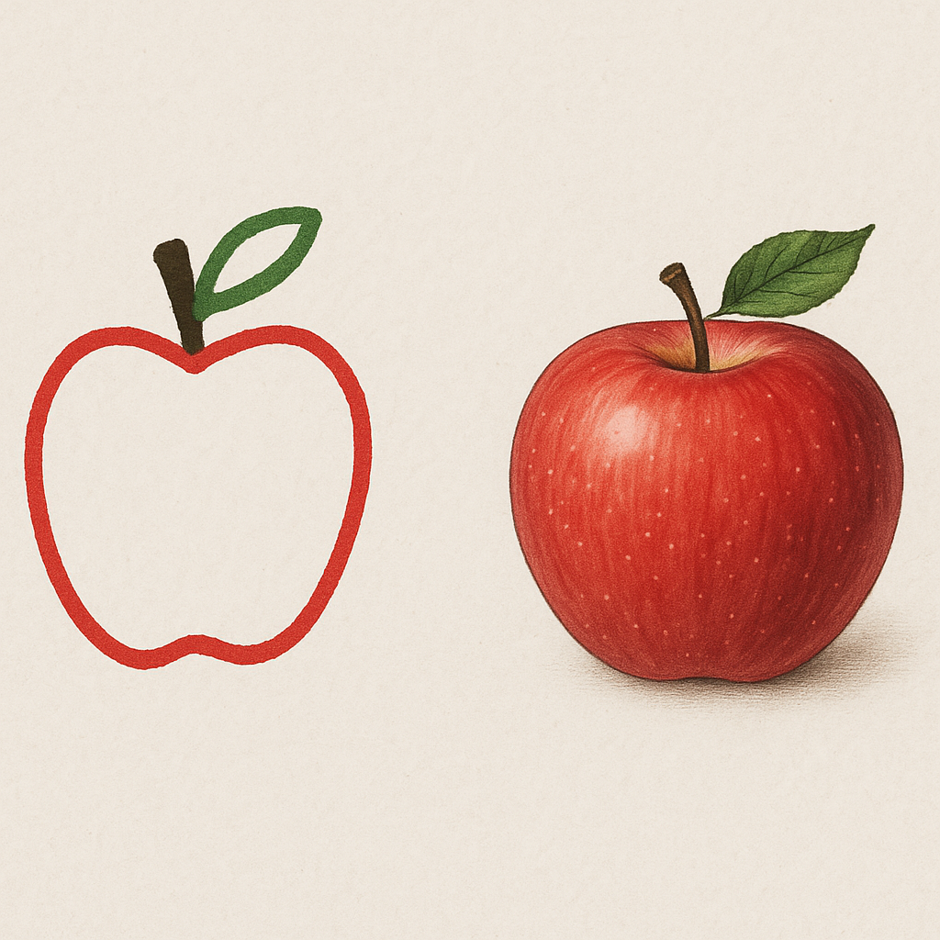
First, embeddings!
Slide Tips
Instructions are not visible during Show Mode
To Insert Image:
Drag the image from your source folder onto the slide or click the placeholder to select a photo
To reposition your photo, click “Picture Format” and then “Crop”
Note:
You can move the mockup where you want in the slide, but take care to select both the mockup background and the image placeholder
The more dimensions we add, the more precise our description becomes.
Modern LLMs have thousands of elements in their embeddings.

Slide 30
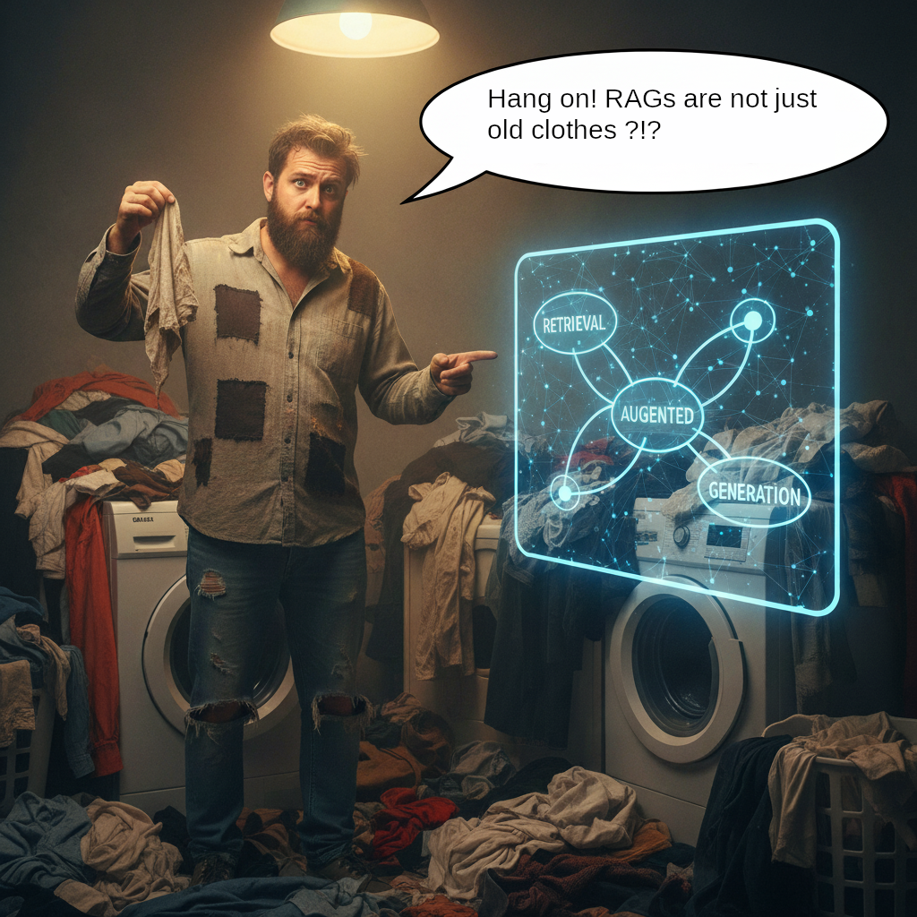
Now, let’s talk about RAG systems!

Slide 31
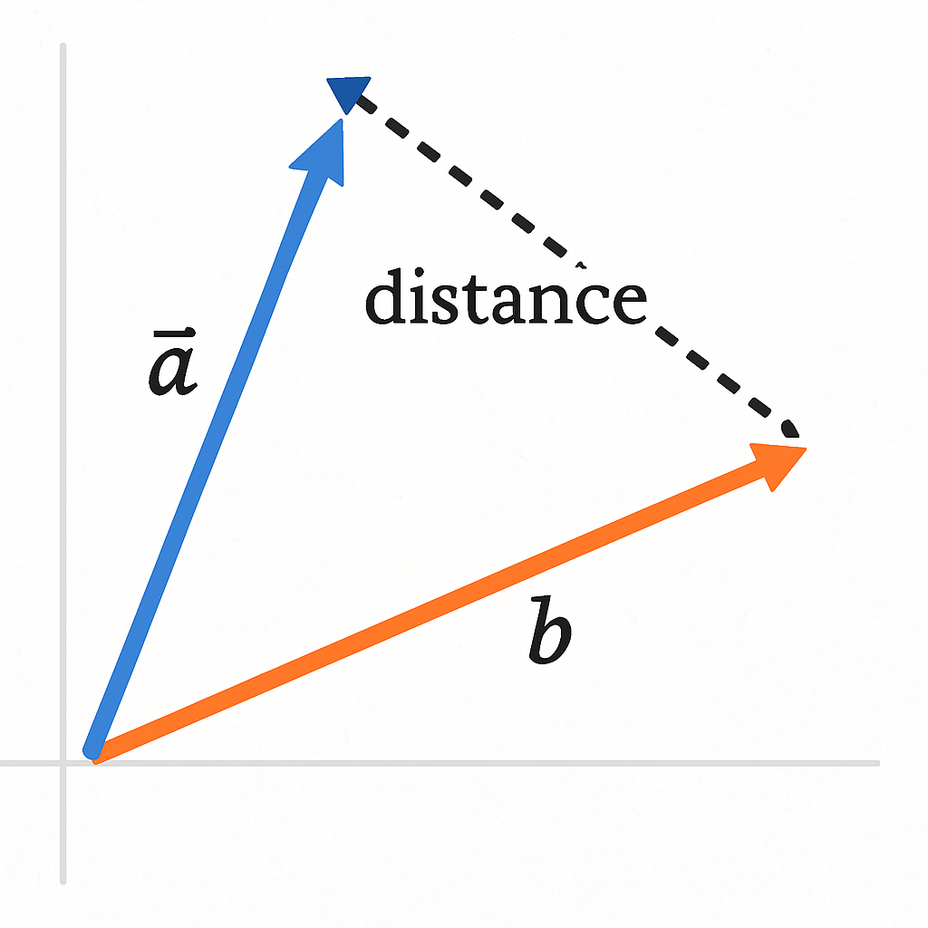
Now, let’s talk about RAG systems!
Slide Tips
Instructions are not visible during Show Mode
To Insert Image:
Drag the image from your source folder onto the slide or click the placeholder to select a photo
To reposition your photo, click “Picture Format” and then “Crop”
Note:
You can move the mockup where you want in the slide, but take care to select both the mockup background and the image placeholder
If we compare the distance between two embeddings vectors, we get a sense of how similar these texts are.
That is the idea behind RAG (Retrieval Augmented Generation) systems.

Slide 32
Now, let’s talk about RAG systems!
We store documents (technical documentation, emails…) and their associated embeddings in a specialized database (called a "vector database")
When we create a prompt, we calculate the prompt's embeddings and compare it to the documents' embeddings in the database.
If the embeddings are similar enough, we return the associated documents to the application.
The application then creates the prompt and adds the content of documents so the documents are in the context window.

Slide 33
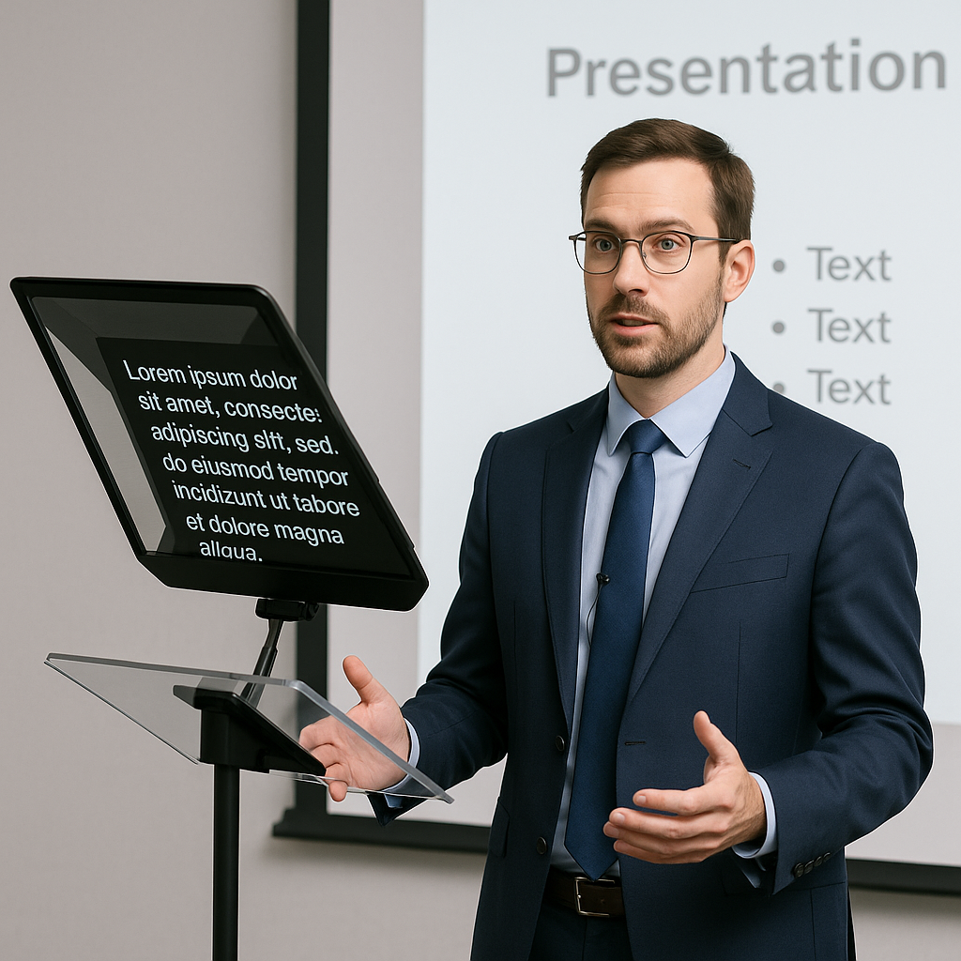
Now, let’s talk about RAG systems!
Think of it as reading your notes before an exam or using a prompter when doing a presentation: you are "reminding" the LLM about things.

Slide 34
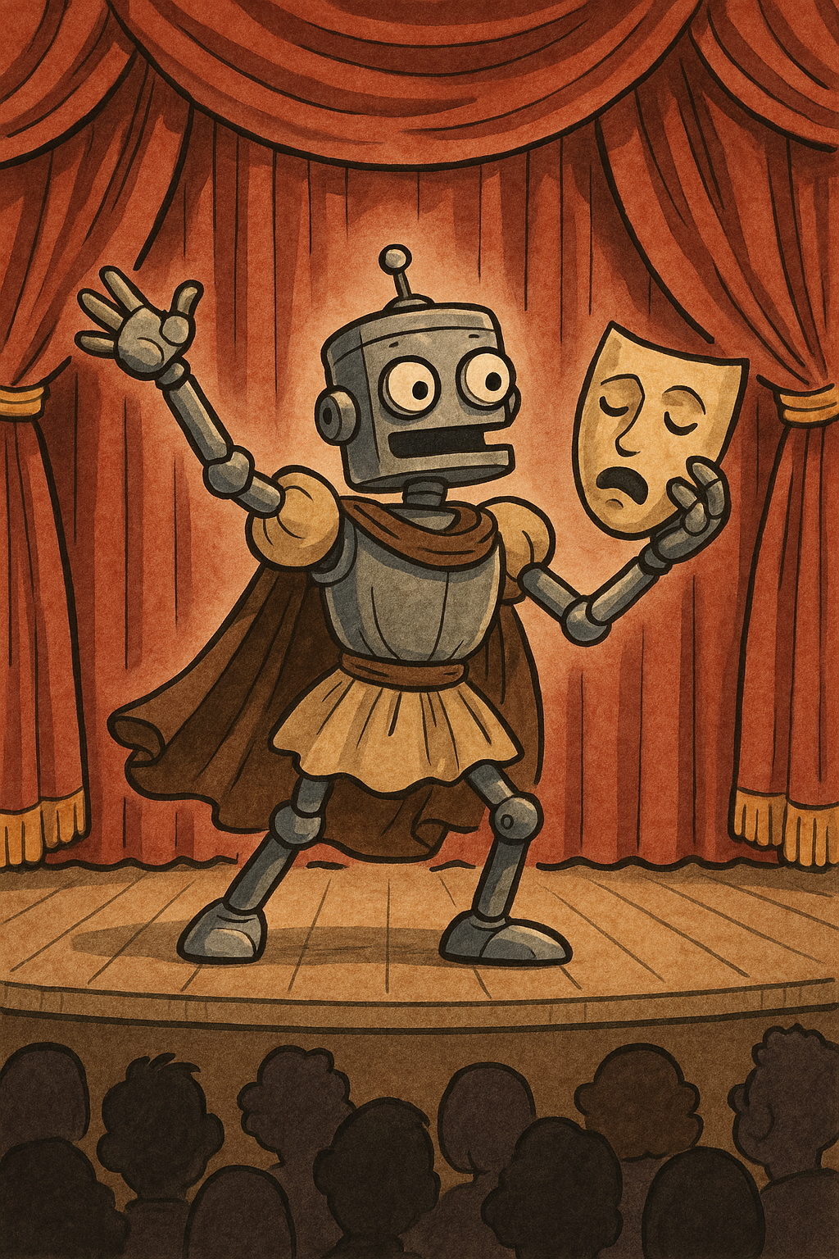
Robots that act: agentic AI

Slide 35
Robots that act: agentic AI
So, now we can ask questions to our LLM and get replies from it. However, if we wanted to take actions from it, we would need to ask the LLM to return the data in a format we can use (JSON, XML...), parse it and then read it.
This is what we did for a bit (with more or less luck) but:
It was error-prone
It was handled differently by each LLM provider
There was no standard
Some approaches were suggested (for example, OpenAI's "function calling") but each one required vendor-specific connectors.

Slide 36
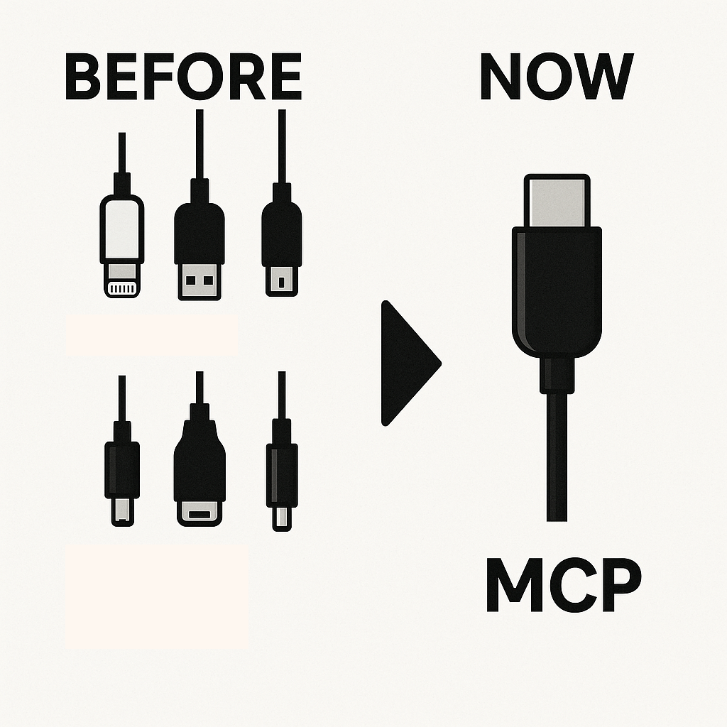
Robots that act: agentic AI
Slide Tips
Instructions are not visible during Show Mode
To Insert Image:
Drag the image from your source folder onto the slide or click the placeholder to select a photo
To reposition your photo, click “Picture Format” and then “Crop”
Note:
You can move the mockup where you want in the slide, but take care to select both the mockup background and the image placeholder
This is why Anthropic introduced the Model Context Protocol (MCP) in 2024.
The MCP is an open standard that defines how LLMs can interact with other tools (databases, tools and workflows).
Before this, each Generative AI and tool provider was offering a different way to integrate with AI systems: using this protocol allowed the software equivalent of the current USB-C port.

Slide 37
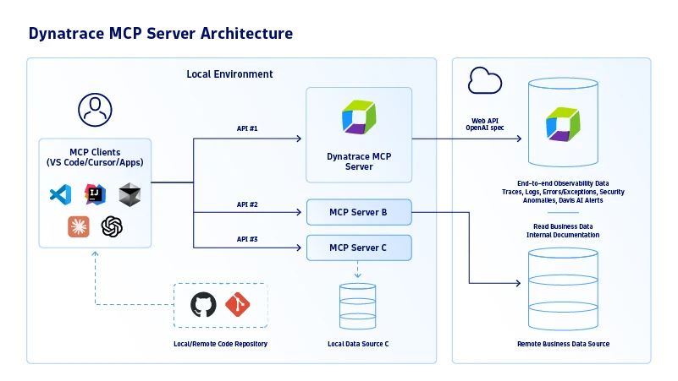
Robots that act: agentic AI
Slide Tips
Instructions are not visible during Show Mode
To Insert Image:
Drag the image from your source folder onto the slide or click the placeholder to select a photo
To reposition your photo, click “Picture Format” and then “Crop”
Note:
You can move the mockup where you want in the slide, but take care to select both the mockup background and the image placeholder
Basically, an AI application (called a "MCP client") connects to resources exposed (locally or remotely) by developers through the MCP protocol. These resources are called "MCP servers".
That way, your client can either receive data from the servers (for example, get data from a database, an email server...) or trigger actions on these servers (therefore making them "agents").

Slide 38
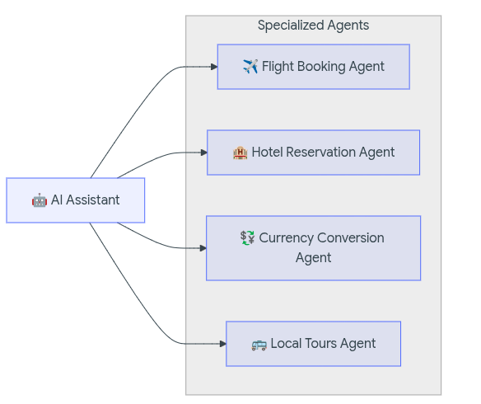
Robots that act: agentic AI
Slide Tips
Instructions are not visible during Show Mode
To Insert Image:
Drag the image from your source folder onto the slide or click the placeholder to select a photo
To reposition your photo, click “Picture Format” and then “Crop”
Note:
You can move the mockup where you want in the slide, but take care to select both the mockup background and the image placeholder
As you can imagine, these agentic systems can interact together.
For example, an agent used to plan a trip could be interacting with:
A flight booking agent
A hotel reservation agent
An agent for local tour recommendations
A currency conversion agent

Slide 39
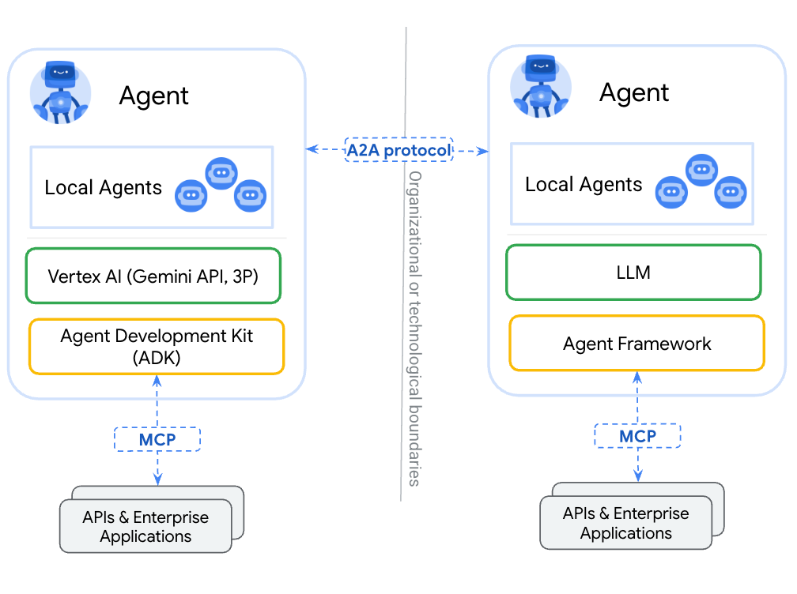
Robots that act: agentic AI
Slide Tips
Instructions are not visible during Show Mode
To Insert Image:
Drag the image from your source folder onto the slide or click the placeholder to select a photo
To reposition your photo, click “Picture Format” and then “Crop”
Note:
You can move the mockup where you want in the slide, but take care to select both the mockup background and the image placeholder
We could wrap each agent as a MCP server but MCP communications are usually stateless and perform specific actions. Using a different protocol for agent to agent (A2A) systems allows more flexibility in the interactions between components that are closer to peers than client/servers.
This is why Google suggested the A2A Protocol in 2025.

Slide 40
Let’s do some coding now!

Slide 41
Introducing our demo application

Slide 42
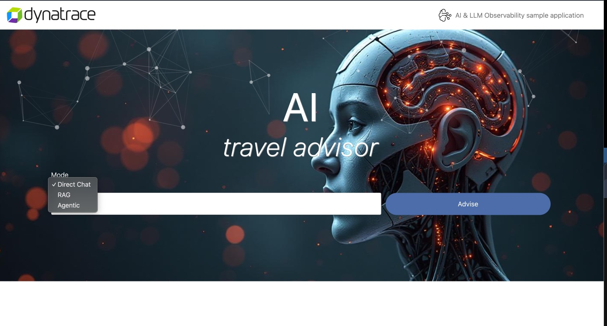
Introducing our demo application
The application is a basic implementation of AI technologies where the user can type the name of a city and then the AI will give back a travel advice depending on the selected Mode enhancing the user input.

Slide 43
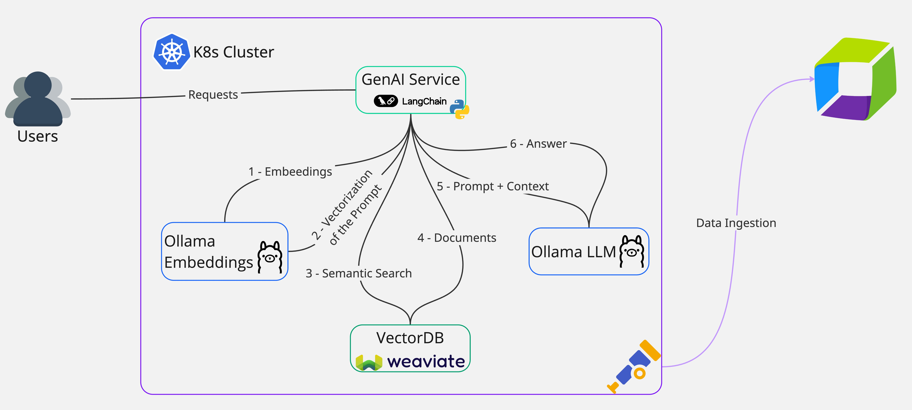
Introducing our demo application
In our AI Travel Advisor App, the RAG pipeline is built using LangChain, with Ollama as the underlying LLM.
The retrieval step reaches out to Weaviate, our vector database, to query for documents relevant to the prompt in input.
⚠️ Let’s do some searches for “Sydney” or “Bali”, with and without RAG!

Slide 44
Introducing our demo application
In our AI Travel Advisor app, we have three different agents:
Valid City: verifies that a prompt is asking about a valid city name
Travel Advice: provides a travel recommendation
Excuse: provides an excuse why the AI chat-bot cannot answer the request
These Agents are orchestrated through LangChain using a complex system prompt.
The orchestrator is the component that moves the control- and data-flow between agents.

Slide 45
OpenLLMetry

Slide 46
OpenLLMetry
OpenLLMetry is an open source library built on top of OpenTelemetry to provide auto-instrumentation for AI Technologies.

Slide 47
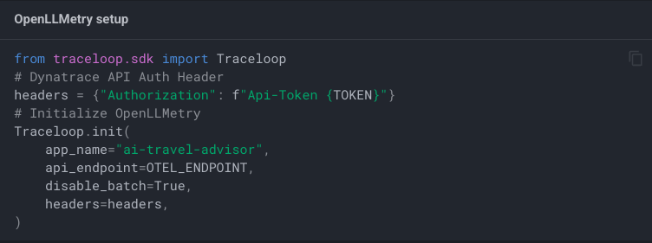
OpenLLMetry
How do we use it?
If we use Python (or Javascript/Typescript), we just need to paste the following code snippet (with the appropriate parameters) in our code.

Slide 48
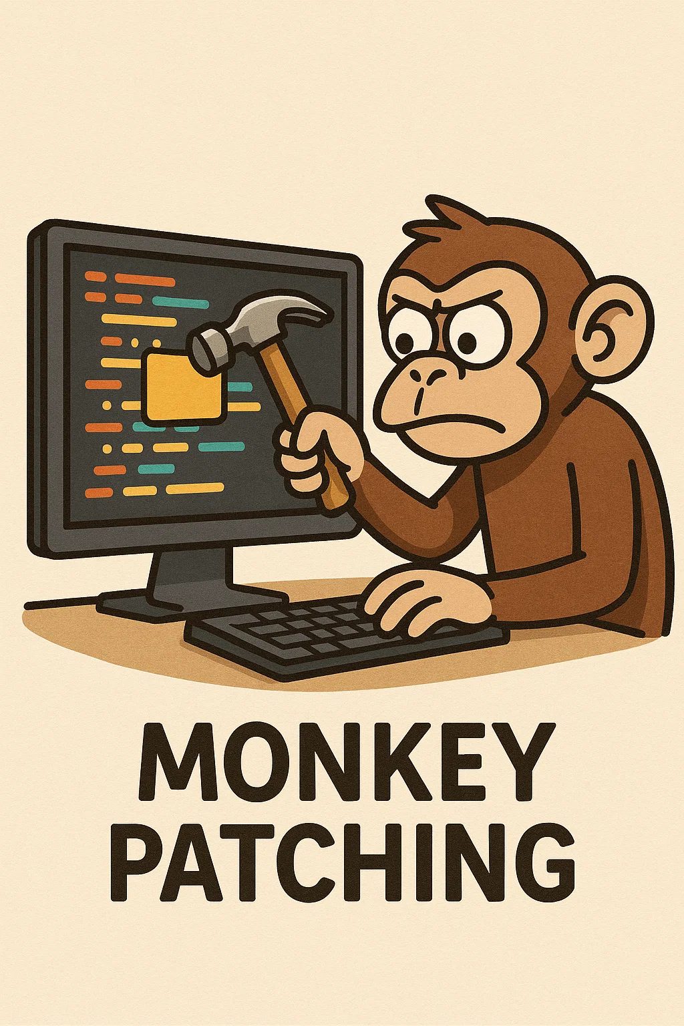
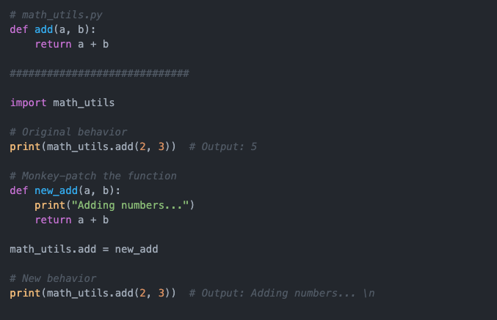
Introducing our demo application
What is this sorcery?
The OpenLLMetry Python and JS/TS libraries leverage a technique called “Monkey patching”.
Other technologies (Java, .Net …) may required manual instrumentation.

